Slide 1
Improving Undergraduate Students’ Reading Compliance Through Behavioral Change
Amit Sharma, Ph.D.
Associate Professor
The School of Hospitality Management

Slide 2
Purpose
The purpose of this project is to evaluate, and improve undergraduate students’ reading compliance decisions:
1) improve understanding of factors that impact undergraduate student reading compliance; and
2) develop strategies to help students improve time self-rationing skills, increase positive perceptions of reading assignments through awareness of longer-term benefits.
Funding: Schreyer Institute for Teaching Excellence (Sharma, PI)

Slide 3
Motivation for this research
Observation of student behavior and attitude towards reading material.
Informal strategies in class since 2008 – Facebook, Twitter, in-class readings, pop-quizzes, etc.
Related research in self-rationing and decision making.

Slide 4
Reading Compliance
Third Grader reading challenges (McCray, Vaughn, & Neal, 2001).
Reading compliance amongst undergraduate students is as low as 20-30% for daily reading assignments (Hobson, 2004).
Low reading compliance impacts scholarly performance of undergraduate students (National Survey of Student Engagement, 2001).
Previously held beliefs that undergraduate students possess appropriate reading abilities being challenged (Bean, 1996).
Student perspective on reading compliance can be valuable to consider (Ivey and Broaddus, 2001).

Slide 5
Theoretical Framework
Behavioral economics literature - individuals could be inefficient in self-rationing (self-regulating) resources (Heath & Soll, 1996; Wertenbroch, 2001).
Time is a valuable economic resource.
Individuals’ ability to make complex decisions of resource allocation to activities with abstract immediate benefits, are limited (Fujita, Trope, Liberman, & Levin-Sagi, 2006).
We hypothesize - students can improve reading compliance by improving time self-rationing decisions; and by increased awareness of short-long term benefits of reading compliance.

Slide 6
The Project
Planning, Phase I – Understanding factors that impact reading compliance – today’s presentation - part of Phase I.
Development, Phase II – Development of strategies to improve reading compliance.
Implementation and Validation, Phase III – Effectiveness of strategies, and evaluation.

Slide 7
Research Design
Research Objective – Phase I: Improve understanding of factors that impact undergraduate student reading compliance.
Undergraduate student focus group discussions
Recruitment challenges: university wide, HHD, SHM
Initially planned three focus groups; concluded with two focus groups, total 12 students
Students from SHM HHD

Slide 8
Data and Analysis
Discussion questions (literature review): reading compliance factors, incentives-penalties, procrastination, time management, support.
Focus groups conducted by Dr. Bart Pursel (SITE) to minimize bias.
Graduate student present to take notes
Audio recorded discussions, one hour each, transcribed.
Transcriptions read by three researchers (Sharma, Pursel, and Van Hoof); Meeting and discussion of transcripts. Content analysis to identify key concepts.
Concept maps to assess patterns, relationships…

Slide 9
Concept Map Coding
Bold – Concepts appear repeatedly
Yellow shaded concepts – More than 1 relationship

Slide 10
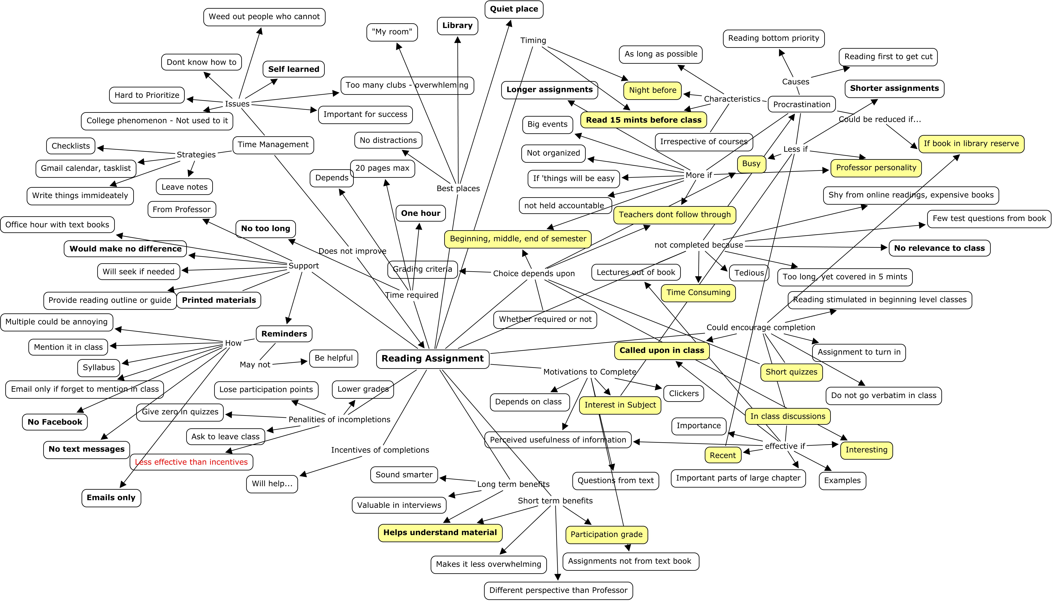
Overall Concept Map

Slide 11
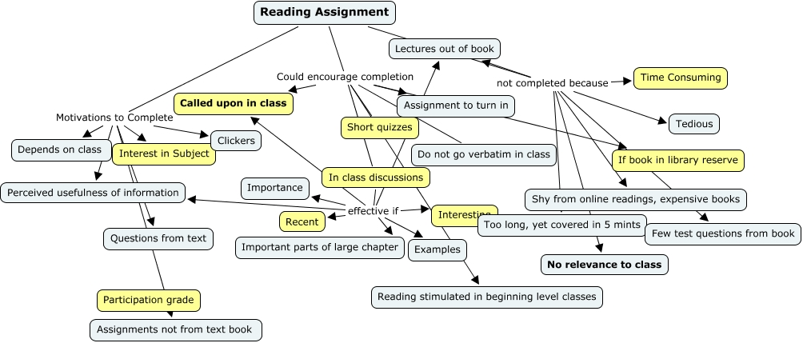
Reading Compliance

Slide 12
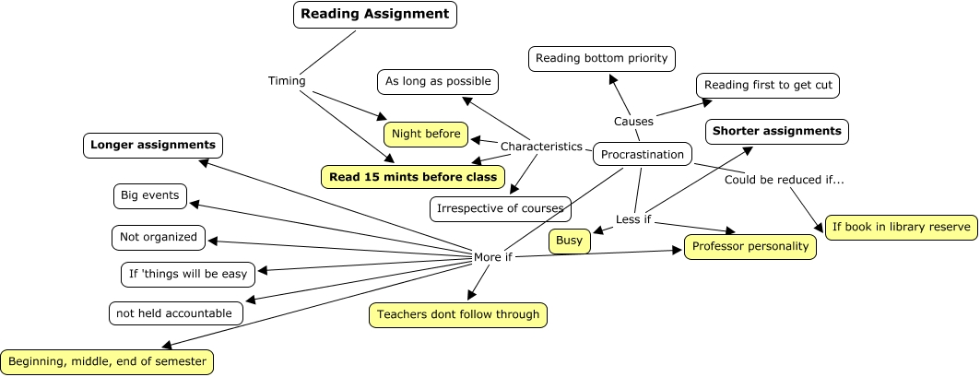
Procrastination

Slide 13
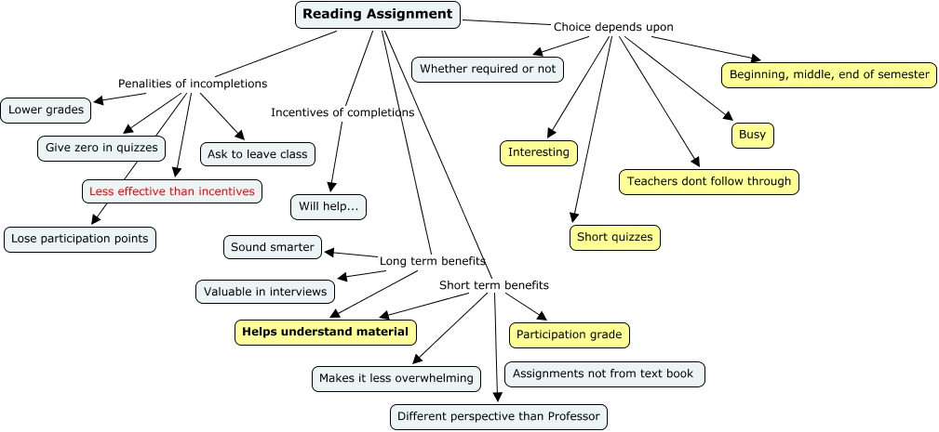
Incentives-Penalties

Slide 14
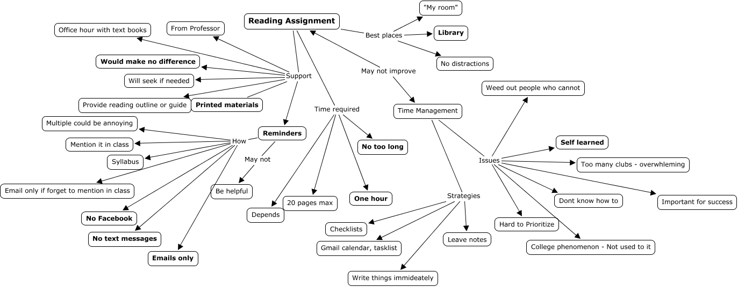
Reading Support

Slide 15
Concepts of Interest
Reading compliance
Challenges – Time consuming, book availability
Could encourage completion – Short quizzes, in-class discussions, interesting and recent readings, called upon in class
Motivations to complete – Interest in subject, participation grade
Incentive-disincentive
Incentives versus disincentives?
Short term benefits – Helps understand materials, participation grade
Choice depends upon – interesting, short quizzes, teacher follow through, busy schedule, semester timing (??)
Long term benefits – ???

Slide 16
Concepts of Interest
Procrastination
Reading timing – Night before, 15 minutes before class
More if – Teachers don’t follow through, semester timing
Less if – Professor personality, busy schedule, if book in library reserve, shorter assignments
Support and time management
Support – May not make a difference, printed materials
Reminders – Emails only, no Facebook or text messages
Time required for reading – Not too long, one hour
Time management – Self learned
Best place to read - Library

Slide 17
Concepts of Interest – prior literature
Surprise quizzes, illustrate practical benefits of reading preparation, emphasize students' responsibility (Sappington, Kinsey, and Munsayac, 2002).
Reading guidelines, structure, graded reading assignments, class discussions, participation grades, relevance to professional development (Janick-Buckner, 1997; Gross Davis, 1999; Monaco and Martin, 2007).
Timely assignment of readings (Gross Davis, 1999); Variety of reading materials (Ivey and Broaddus, 2001); Millennial generation learning techniques: technology pressured (Wilson, 2004; Considine, Horton, and Moorman, 2009)

Slide 18
Questions of Interest
Reading compliance
What are the perceptions and attitudes of students?
What is the magnitude of this problem?
What are students’ challenges that prevent them from complying?
How could instructors encourage compliance?
What are the motivations to comply?
Incentive-disincentive
What works better, incentives or disincentives? Or Both?
What are the perceived short term benefits?
What are the perceived long term benefits?
How do students choose between reading assignments?

Slide 19
Questions of Interest
Procrastination
How can students be encouraged to read sooner than the night before or 15 minutes before class?
Support and time management
Would support make a difference? If so, what kind of support?
Such as, reminders, special skills to manage course work and non-academic activities, etc.
Others
What are the millennial generation factors that may impact compliance?
How can this impact by reduced/minimized/countered?

Slide 20
Next Research Phases
Planning, Phase I (continued) - University wide survey of undergraduate students, develop strategies to improve reading compliance decisions.
Development, Phase II – Develop interventions and experimental design for selected courses.
Implementation, validation, Phase III – Implement and test effectiveness of strategies in courses taught by the PI and collaborators.

Slide 21
Research Team
Amit Sharma, PI
Collaborators (Alphabetically):
Lisa Bailey-Davis, M.S., R.D. (Senior Instructor, Hershey)
Dave Cranage, Ph.D. (Associate Professor, SHM)
Martha Conklin, Ph.D. (Associate Professor, SHM)
Rick Gilmore, Ph.D. (Associate Professor, Psychology)
Kathy Jackson, Ph.D. (Senior Research Associate, SITE)
Kyle Peck, Ph.D. (Associate Dean - Research, Education)
Bart Pursel, Ph.D. (Research Associate, SITE)
Rama Radhakrishna, Ph.D. (Professor, Ag. Sc.)
Bert Van Hoof, Ph.D. (Professor, SHM)
Special thank you to R. Neill Johnson, Ph.D. (Formerly SITE)

Slide 22
Questions for the audience
Is reading compliance an issue in your classes?
Do you think it needs to be addressed during students’ undergraduate experience?
Can you think of other issues that come to mind, that may impact reading compliance for this generation of students?
Any strategies that you have found successful?
Any suggestions or comments on this presentation, and the research so far?

Slide 23
Thank You.
Q&A

Slide 24
Theoretical Framework
Construal Level Theory (CLT) and Mental Accounting (MA) (Thaler, 1985; Fujita et al., 2006).
Behavioral economics literature - individuals could be inefficient in self-rationing (self-regulating) resources (Heath & Soll, 1996; Wertenbroch, 2001).
Time is a valuable economic resource.
Individuals’ ability to make complex decisions of resource allocation to activities with abstract immediate benefits, are limited (Fujita, Trope, Liberman, & Levin-Sagi, 2006).

Slide 25
Theoretical Framework
We hypothesize that students can improve reading compliance by improving their time self-rationing decisions; and appreciating short and long term benefits of reading compliance.

Slide 26
Concepts of Interest – prior literature
Consider surprise quizzes, illustrate practical benefits of reading preparation, and emphasize students' responsibility in the learning enterprise (Sappington, Kinsey, and Munsayac, 2002).
Reading guidelines, graded reading assignments, class discussions, participation grades, relevance to professional development (Janick-Buckner, 1997; Gross Davis, 1999).
Timely assignment of readings (Gross Davis, 1999).

Slide 27
Concepts of Interest – prior literature
Variety of reading materials (middle school students) (Ivey and Broaddus, 2001).
Millennial generation learning techniques: technology (Wilson, 2004; Considine, Horton, and Moorman, 2009); pressured
Structure in learning (Monaco and Martin, 2007).

Slide 28
Concepts of Interest – prior literature
Millennial generation learning techniques: technology pressured (Wilson, 2004; Considine, Horton, and Moorman, 2009)

