Slide 1
Educating for Sustainability
A panel discussion for the
Schreyer Institute for Teaching Excellence
Andy Lau
Associate Director, Penn State Center for Sustainability
February 5, 2009

Slide 2
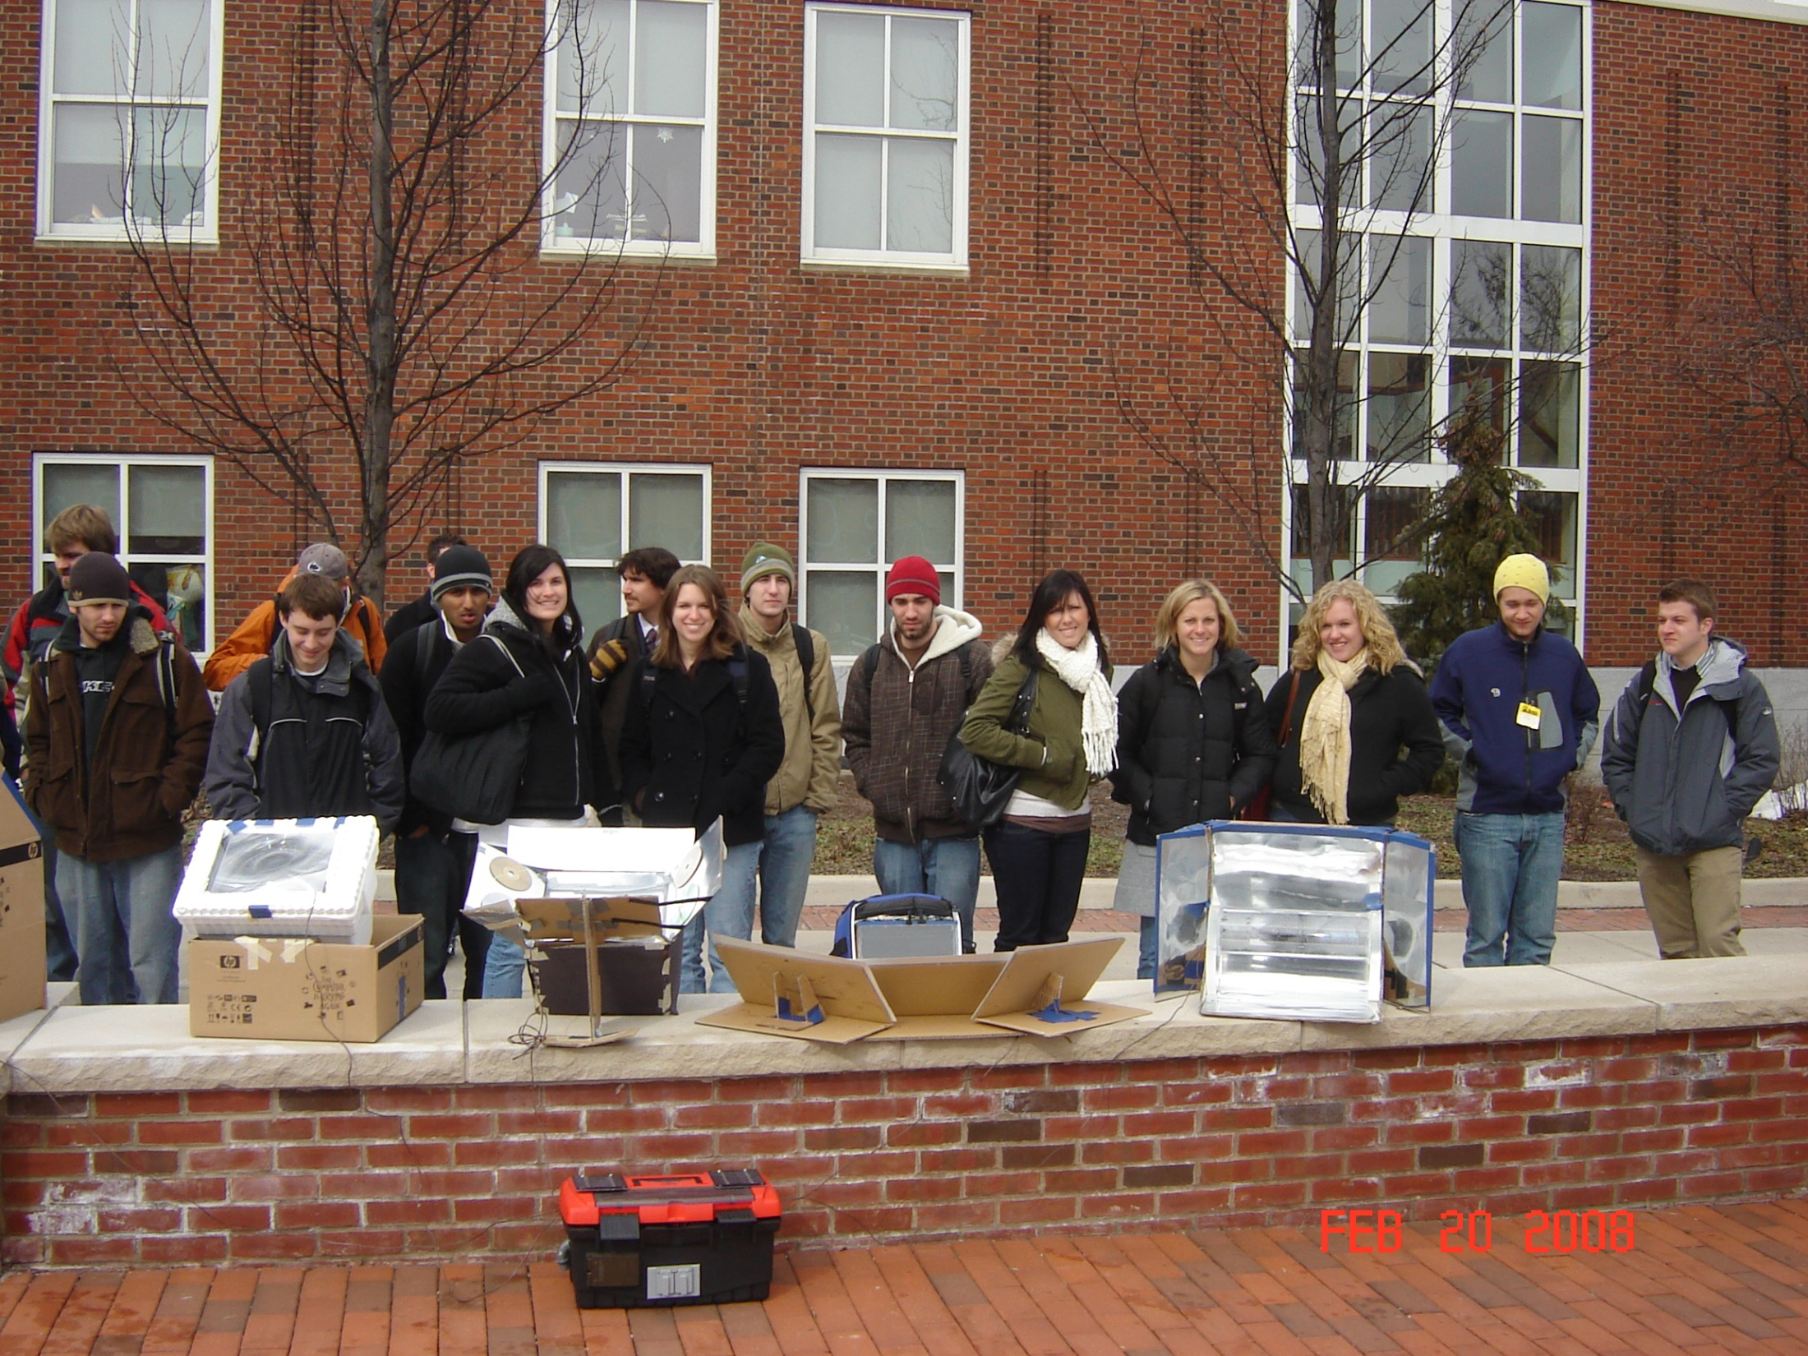
Questions
What is sustainability?
What are the principles of sustainability?
How do we teach it?
What does it mean for Penn State and higher ed?

Slide 3
What is sustainability?
It is a way of living that strives to make life better …
For all people alive today
For all living creatures alive today
For all of life in the future
In other words, it is a an ethic for living that emphasizes responsibility to quality of life for now and the future.
Its watchword … Harmony

Slide 4
What are the principles?
From Andres Edwards, The Sustainability Revolution, the common themes are:
Stewardship
Respect for limits
Interdependence
Economic restructuring
Fair distribution
Intergenerational perspective
Nature as a model and teacher.
Religion, ethics
Ecology, ethics
Politics, ecology
Economics, ethics
Ethics, Sociology
HHD, ethics
Ecology, Biology

Slide 5
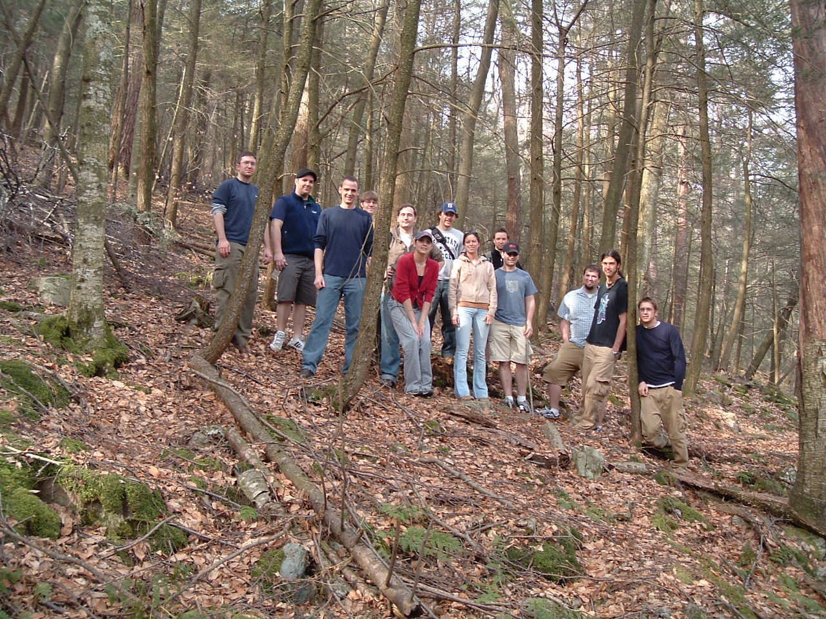
How do we teach it?
Systems
Multi-disciplinary
Values
Nature
I=PAT
Projects

Slide 6
What does it mean for Penn State and higher ed?
“Long ago we surrendered the idea of guiding students to a larger vision of self and life in favor of merely well-paying careers.” David Orr, The Nature of Design
Become “learning organizations” to reinvent HE
Systems thinking: change who has lunch with whom
Engage real & messy problems
Get off corporate welfare
Need leaders

