Slide 1
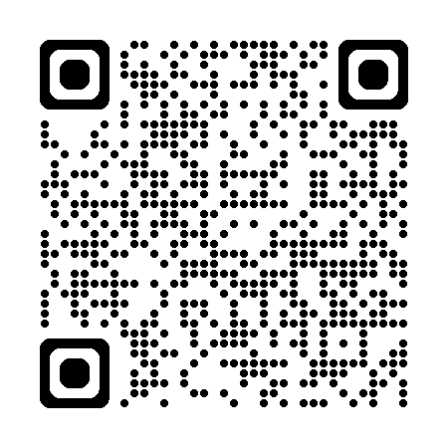
MSEEQs
Midsemester Feedback
Please take the first 10 minutes of class to complete the MSEEQs for this course.
Fall 2025 Mon. 9/29 to Sun. 10/12 until 11:59 pm
Notes:
Wait outside the classroom because students will feel pressure if you are in the room.
“Mid-semester feedback is important to me because it helps me understand your experience/learning and make mid-course changes that can benefit you.”
“I want to hear from you whether your feedback is positive, neutral, or negative.”
Your responses are aggregated and anonymous.

Slide 2
SEEQs
End-of- semester Feedback
Please take the first 10 minutes of class to complete the SEEQs for this course.
Fall 2025 Mon. 11/24 - Sun. 12/14 @ 11:59 pm
Notes:
Wait outside the classroom because students will feel pressure if you are in the room.
“Your feedback is important because it helps me understand experience of the course and make changes to improve it for future students.”
“I want to hear from you whether your feedback is positive, neutral, or negative.”
“Your responses help me understand how feel about your engagement with the material, other students, and me.”
“In the past, I’ve made changes to (provide examples to students) based on student feedback.”

Slide 3
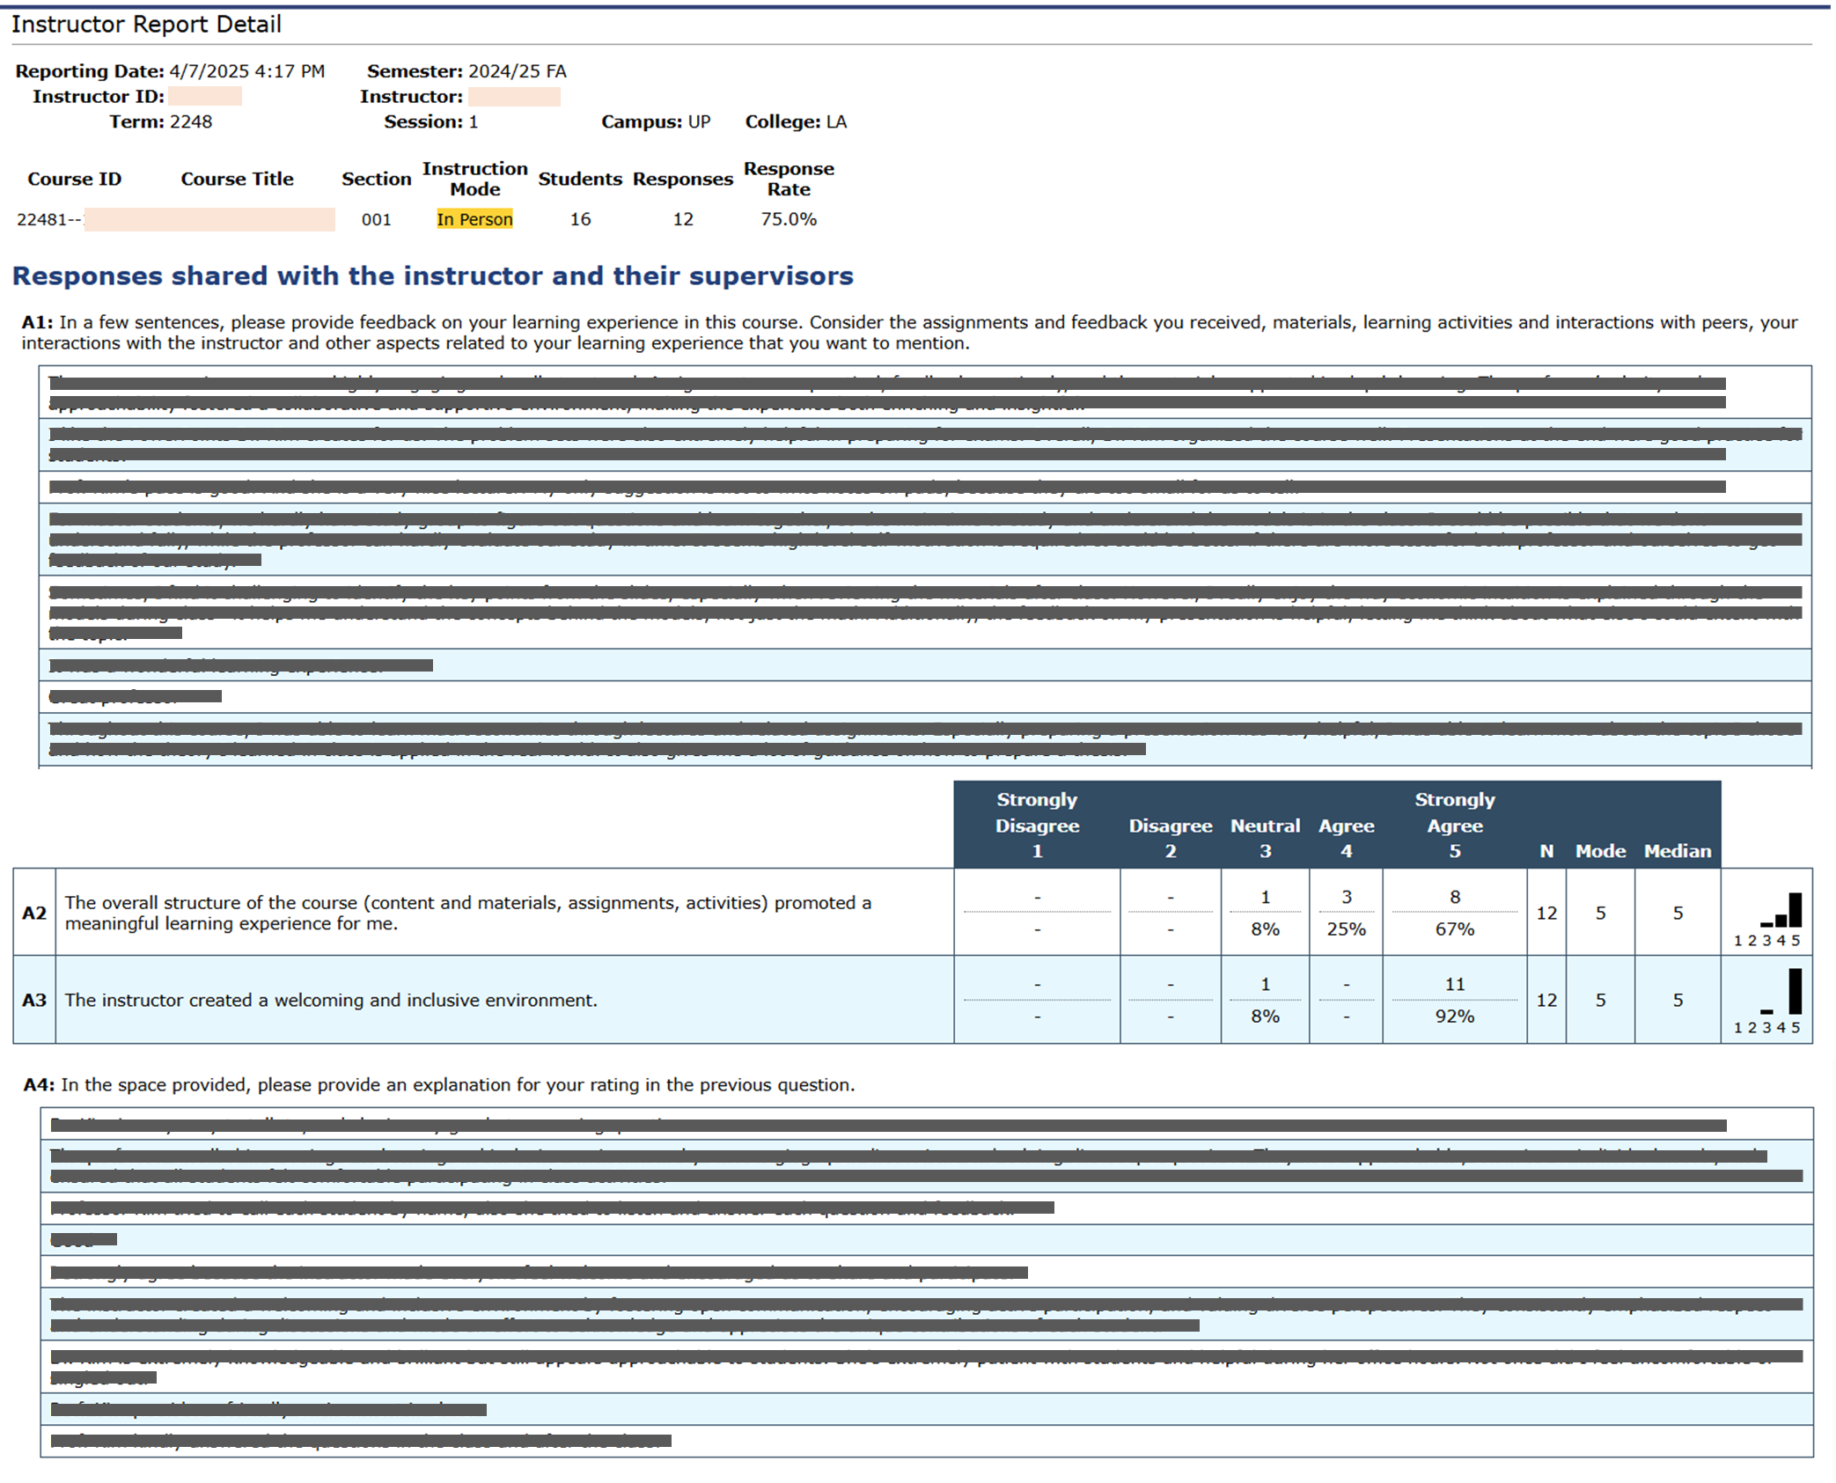
This is a screenshot of the Instructor Report.
Student responses to each question are grouped together.
Notes:
Above is a screenshot of a real SEEQ Report, with the student feedback blocked out. Students may be relieved to see a report because it shows that their responses are aggregated and thus anonymous. Each row in the written feedback table represents a different student. Students do not necessarily respond to all questions. As a result, for example, the 3rd response in the open text questions are not necessarily from the same student.

