Slide 1
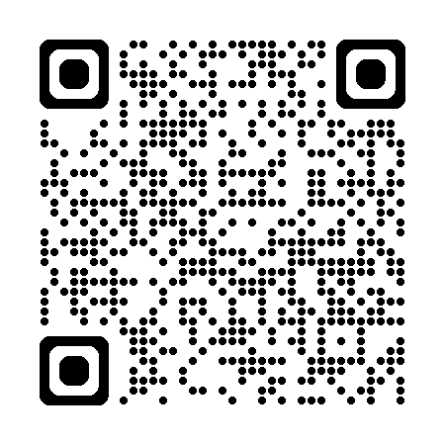
MSEEQs
Midsemester Feedback
Please take the first 10 minutes of class to complete the MSEEQs for this course.
MSEEQs are anonymous and results go only to the instructor. They are open during weeks 6 & 7 of the semester (including weekends).
Notes:
Wait outside the classroom because students will feel pressure if you are in the room.
“Mid-semester feedback is important to me because it helps me understand your experience/learning and make mid-course changes that can benefit you.”
“I want to hear from you whether your feedback is positive, neutral, or negative.”
Your responses are aggregated and anonymous. (see next slide to show how student responses are aggregated)

Slide 2
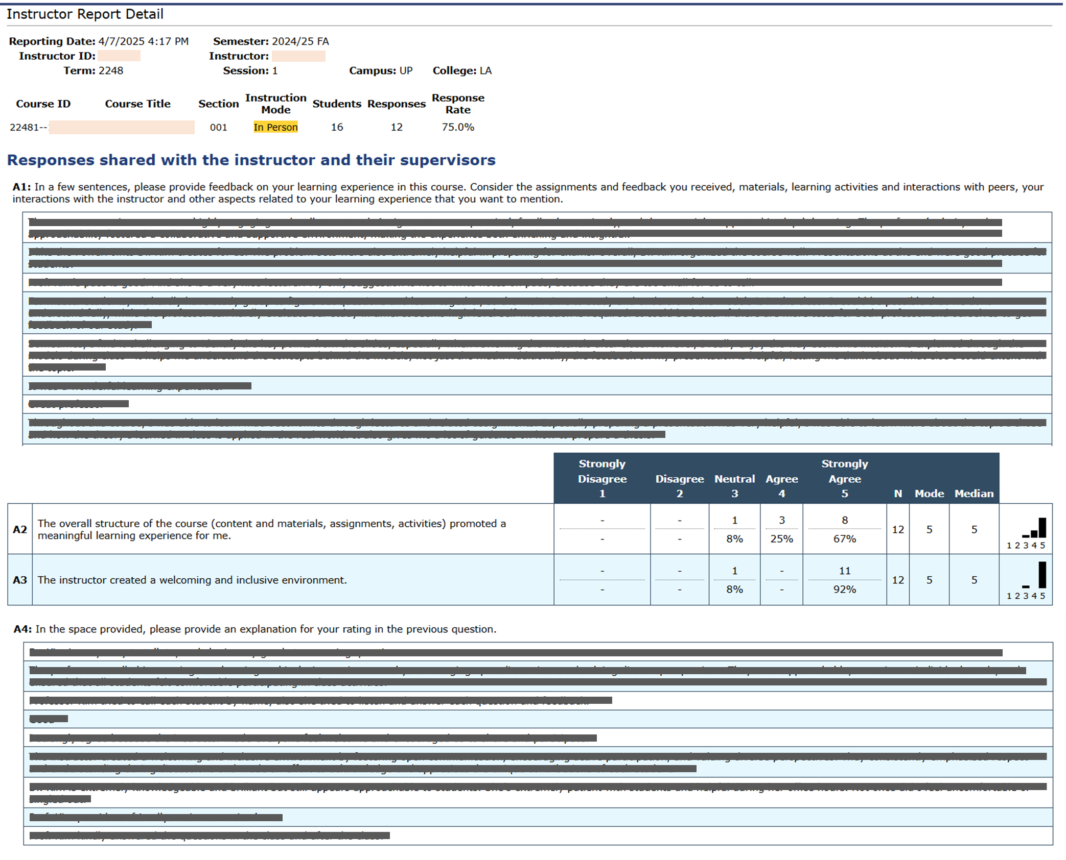
This is a screenshot of the report seen by the Instructor.
Anonymous student responses for each question are grouped together.
Some students skip a question. So the 2nd responses in A1 & A4 might be from different students.
Notes:
Above is a screenshot of a real SEEQ Report, with the student feedback blocked out. Students may be relieved to see a report because it shows that their responses are aggregated and thus anonymous. Each row in the written feedback table represents a different student. Students do not necessarily respond to all questions. As a result, for example, the 3rd response in the open text questions are not necessarily from the same student.

