Slide 1
Slides from Dr. Saundra McGuire’s presentation at Penn State, February 12, 2018
It is fine—and even encouraged—by Dr. McGuire to use and adapt these slides for use with your own students
Dr. McGuire welcomes your questions and comments via email: smcgui1@lsu.edu
For Penn State faculty: 20% off Saundra McGuire titles—see next slide for details

Slide 2
For Penn State faculty: 20% off Saundra McGuire titles
Discount code: SM20
Offer expires 12/31/18
https://styluspub.presswarehouse.com/Books/AuthorDetail.aspx?id=29061

Slide 3
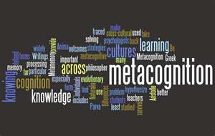
Get Students to Focus on Learning Instead of Grades:
Metacognition is the Key!
Saundra Yancy McGuire, Ph.D.
Retired Asst. Vice Chancellor & Professor of Chemistry
Director Emerita, Center for Academic Success
Louisiana State University

Slide 4
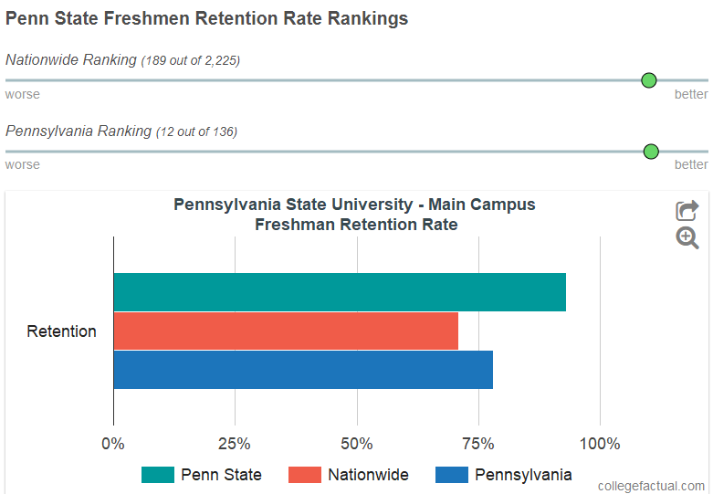
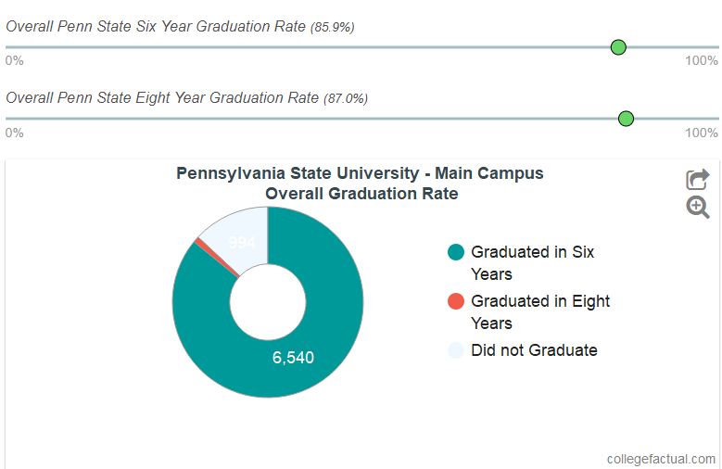
Penn State
Retention and Graduation Rates
www.collegefactual.com/colleges/pennsylvania-state-university-main-campus/academic-life/graduation-and-retention/

Slide 5
How Might Penn State University
Improve These Rates?
Teach Students Metacognitive Learning Strategies
Help Students Develop the Right Mindset
Motivate Students to Implement Effective Learning Strategies

Slide 6
Metacognition
The ability to:
think about your own thinking
be consciously aware of yourself as a problem solver
monitor, plan, and control your mental processing (e.g. “Am I understanding this material, or just memorizing it?”)
accurately judge your level of learning
know what you know and what you don’t know
Flavell, J. H. (1976). Metacognitive aspects of problem solving. In L. B. Resnick (Ed.), The nature of intelligence (pp.231-236). Hillsdale, NJ: Erlbaum

Slide 7


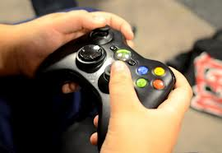
Why haven’t most students already developed these skills?
It wasn’t necessary

Slide 8
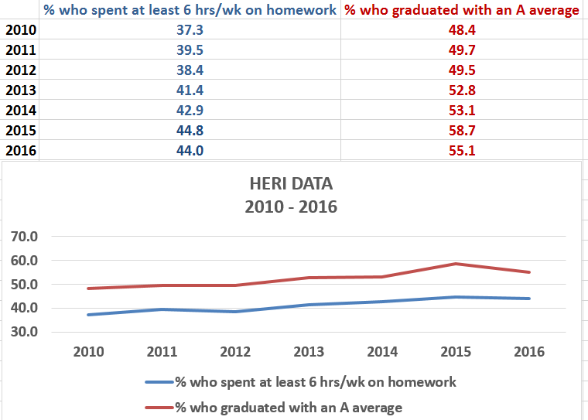
Data from UCLA Higher Education Research Institute (HERI)
First Year Student Survey – 2010 - 2016
http://www.heri.ucla.edu

Slide 9
What did most of your teachers in high school do the day before the test?
How do you think most students would answer the following?
What did they do during this activity?
What grade would you have made on the test if you had gone to class only
on the day before the test?

Slide 10

Faculty Must Help Students
Make the Transition to College
Help students identify and close “the gap”
current behavior current grades
productive behavior desired grades

Slide 11
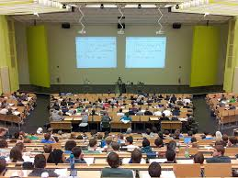
Power of Metacognitive Learning Strategies
Sydnie’s Story: Intro and emails
First encounter on September 23, 2013
Email on October 14, 2013
Email on January 9, 2014
Email on January 20, 2014
Email on May 7, 2014
Update on July 26, 2016 Cum GPA 3.5
Email on February 7, 2017 Cum GPA 3.6
Fall Sem GPA 4.18

Slide 12
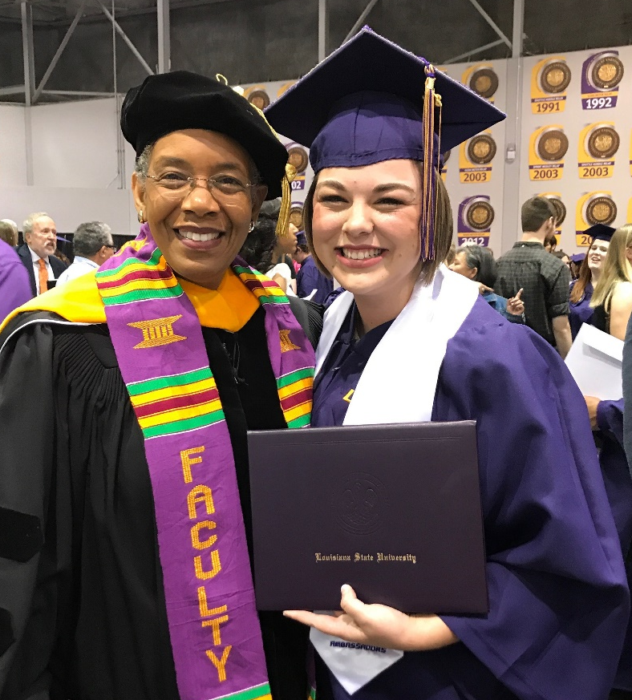
Sydnie Landry, BS in Biology, May 2017
Louisiana State University
Final Semester GPA: 3.77
Applying to Medical School in Fall 2017
Intended Specialty: Dermatology

Slide 13
Effective Homework Strategy
Study material first, before looking at the problems/questions
Work example problems (without looking at the solutions) until you get to the answer
Check to see if answer is correct
If answer is not correct, figure out where mistake was made, without consulting solution
Work homework problems/answer questions as if taking a test

Slide 14
Impact of Using Homework Strategy
Sydnie L.
First Year Biology Pre-Med Honors College Student
Email on January 20, 2014
I started to use the "Get more out of your homework" method. I reviewed my notes right before attempting my homework problems, and tried to work the problems without help from the solutions manual or tutors. If I still could not get the right answer, I'd look at my notes again to get a hint, but not to study the problem and mimic it step by step…

Slide 15
Reflection Questions
What’s the difference, if any, between studying and learning?
For which task would you work harder?
A. Make an A on the test
B. Teach the material to the class

Slide 16
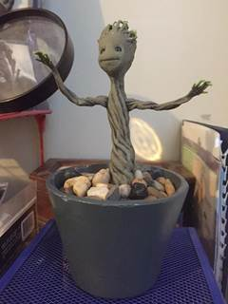
Power of Teaching to Master Learning
Clint’s Story: Baby Groot and the Licensure Exam
Guardians of the Galaxy
First encounter on October 29, 2015 at EKU
Email on January 18, 2016
Msg on April 14, 2016
Msg on June 11, 2016
https://www.youtube.com/watch?v=BEPbXYzE5_Y

Slide 17
The Story of Two Students
Travis, junior psychology student
47, 52, 82, 86 B in course
Dana, first year physics student
80, 54, 91, 97, 90 (final) A in course

Slide 18
Travis, junior psychology student
47, 52, 82, 86
Problem: Reading Comprehension
Solution: Preview text before reading*
Develop questions*
Read one paragraph at a time
and paraphrase information
* Developing an anticipatory set

Slide 19
A Reading Strategy that Works: SQ5R
Survey (look at intro, summary, bold print, italicized words, etc.)
Question (devise questions survey that you think the reading will answer)
Read (one paragraph at a time)
Recite (summarize in your own words)
Record or wRite (annotate in margins)
Review (summarize the information in your words)
Reflect (other views, remaining questions)

Slide 20
Before and After
Robert, freshman chemistry student
42, 100, 100, 100 A in course
Michael, senior pre-med organic student
30, 28, 80, 91 B in course
Miriam, freshman calculus student
37.5, 83, 93 B in course
Ifeanyi, sophomore thermodynamics student
67, 54, 68, 95 B in course
Terrence, junior Bio Engineering student
GPA 1.67 cum, 3.54 (F 03), 3.8 (S 04)
Meaningful Learning Rote Learning

Slide 21



Why is Fast and Dramatic
Increase Possible?
It’s all about the strategies, and getting them to engage their brains!

Slide 22
Counting Vowels in 45 seconds
How accurate are you?
Count all the vowels
in the words on the next slide.

Slide 23
Dollar Bill
Dice
Tricycle
Four-leaf Clover
Hand
Six-Pack
Seven-Up
Octopus
Cat Lives
Bowling Pins
Football Team
Dozen Eggs
Unlucky Friday
Valentine’s Day
Quarter Hour

Slide 24

How many words or phrases do you remember?

Slide 25
Let’s look at the words again…
What are they arranged
according to?

Slide 26
Dollar Bill
Dice
Tricycle
Four-leaf Clover
Hand
Six-Pack
Seven-Up
Octopus
Cat Lives
Bowling Pins
Football Team
Dozen Eggs
Unlucky Friday
Valentine’s Day
Quarter Hour

Slide 27
NOW, how many words or phrases do you remember?

Slide 28
2. We knew how the information was organized
What were two major differences
between the two attempts?
1. We knew what the task was

Slide 29

Bransford, J.D., Brown, A.L., Cocking, R.R. (Eds.), 2000. How people learn: Brain, Mind, Experience, and School. Washington, DC: National Academy Press.

Slide 30
What we know about learning
Active learning is more lasting than passive learning
-- Passive learning is an oxymoron*
Thinking about thinking is important
  Metacognition**
The level at which learning occurs is important
  Bloom’s Taxonomy***
  *Cross, Patricia, “Opening Windows on Learning” League for Innovation in the Community College, June 1998, p. 21.
** Flavell, John, “Metacognition and cognitive monitoring: A new area of cognitive–developmental inquiry.” American Psychologist, Vol 34(10), Oct 1979, 906-911.
*** Bloom Benjamin. S. (1956). Taxonomy of Educational Objectives, Handbook I: The Cognitive Domain. New York: David McKay Co Inc.

Slide 31
This pyramid depicts the different levels of thinking we use when learning. Notice how each level builds on the foundation that precedes it. It is required that we learn the lower levels before we can effectively use the skills above.
Bloom’s Taxonomy
Creating
Putting elements together to form a coherent or functional whole; reorganizing elements into a new pattern or structure through generating,
planning, or producing.
Making judgments based on criteria and standards through checking and critiquing.
Evaluating
Breaking material into constituent parts, determining how the parts relate to one another and to an overall structure .
Analyzing
Carrying out or using a procedure through executing, or implementing.
Applying
Constructing meaning from oral, written, and graphic messages through interpreting, exemplifying, classifying, summarizing, inferring, comparing, and explaining.
Understanding
Retrieving, recognizing, and recalling relevant knowledge from
long-term memory.
Remembering
http://www.odu.edu/educ/llschult/blooms_taxonomy.htm

Slide 32

When we teach students about Bloom’s Taxonomy…
They GET it!

Slide 33
How do you think students answered?
At what level of Bloom’s did you have to operate to make A’s or B’s in high school?
Remembering
Understanding
Applying
Analyzing
Evaluating
Creating

Slide 34
How do you think students answered?
At what level of Bloom’s do you think you’ll need to operate to make A’s in college courses?
Remembering
Understanding
Applying
Analyzing
Evaluating
Creating

Slide 35
How students answered (2008)
At what level of Bloom’s did you have to operate to make A’s or B’s in high school?
Remembering
Understanding
Applying
Analyzing
Evaluating
Creating

Slide 36
How students answered (in 2008)
At what level of Bloom’s do you think you’ll need to operate to make an A’s in college?
Remembering
Understanding
Applying
Analyzing
Evaluating
Creating

Slide 37
At what level of Bloom’s did you have to operate to make A’s or B’s in high school?
How students answered (2013)
Remembering
Understanding
Applying
Analyzing
Evaluating
Creating

Slide 38
How students answered (in 2013)
At what level of Bloom’s do you think you’ll need to operate to make A’s in college?
Remembering
Understanding
Applying
Analyzing
Evaluating
Creating

Slide 39
At what level of Bloom’s did you have to operate to make A’s and B’s in high school?
How students answered (2014)
Remembering
Understanding
Applying
Analyzing
Evaluating
Creating

Slide 40
At what level of Bloom’s do you think you’ll need to operate to make A’s in college?
How students answered (in 2014)
Remembering
Understanding
Applying
Analyzing
Evaluating
Creating

Slide 41
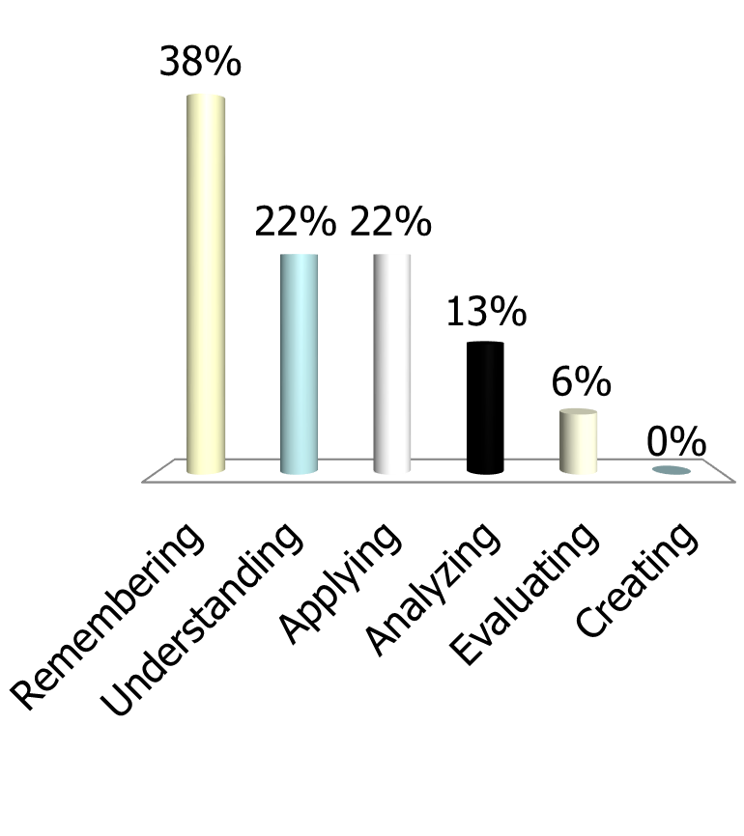
At what level of Bloom’s did you have to operate to make A’s and B’s in high school?
How students answered (2017)
Remembering
Understanding
Applying
Analyzing
Evaluating
Creating

Slide 42
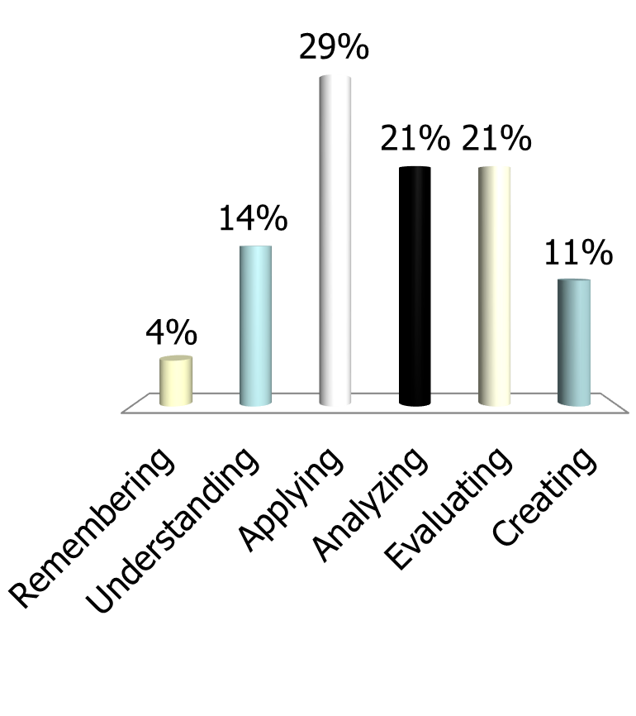
At what level of Bloom’s do you think you’ll need to operate to make A’s in college?
How students answered (in 2017)
Remembering
Understanding
Applying
Analyzing
Evaluating
Creating

Slide 43
How do we teach students to move higher on Bloom’s Taxonomy?
Teach them the Study Cycle*
*adapted from Frank Christ’s PLRS system

Slide 44

The Study Cycle
4
Reflect
3
Review
Preview
Preview before class – Skim the chapter, note headings and boldface words, review summaries and chapter objectives, and come up with questions you’d like the lecture to answer for you.
4
Reflect
Attend
Attend class – GO TO CLASS! Answer and ask questions and take meaningful notes.
Review after class – As soon after class as possible, read notes, fill in gaps and note any questions.
Review
Study – Repetition is the key. Ask questions such as ‘why’, ‘how’, and ‘what if’.
Intense Study Sessions* - 3-5 short study sessions per day
Weekend Review – Read notes and material from the week to make connections
Study
Assess your Learning – Periodically perform reality checks
Am I using study methods that are effective?
Do I understand the material enough to teach it to others?
Assess
*Intense Study Sessions
1 | Set a Goal | (1-2 min) | Decide what you want to accomplish in your study session
2 | Study with Focus | (30-50 min) | Interact with material- organize, concept map, summarize, process, re-read, fill-in notes, reflect, etc.
3 | Reward Yourself | (10-15 min) | Take a break– call a friend, play a short game, get a snack
4 | Review | (5 min) | Go over what you just studied
Center for Academic Success
B-31 Coates Hall ▪ 225.578.2872 ▪www.cas.lsu.edu

Slide 45

What happens when we teach metacognitive learning strategies, Bloom’s Taxonomy, and the Study Cycle to an entire class, not just individuals?

Slide 46
Performance in Gen Chem I in 2011 Based on One Learning Strategies Session*
Attended Absent
Exam 1 Avg: 71.65% 70.45%
Exam 2 Avg: 77.18% 68.90%
Final course Avg*: 81.60% 70.43%
Final Course Grade: B C
The one 50-min presentation on study and learning strategies was followed by an improvement of one full letter grade
*Cook, E.; Kennedy, E.; McGuire, S. Y. J. Chem. Educ., 2013, 90 (8), 961–967

Slide 47
Performance in Gen Chem 1202 Sp 2013 Based on One Learning Strategies Session
Attended Absent
Exam 1 Avg: 71.33% 69.27%
Homework Total: 169.8 119.1
Final course Avg*: 82.36% 67.71%
Final Course Grade: B D
The 50-min presentation on study and learning strategies was followed by an improvement of two letter grades

Slide 48
Performance in Gen Chem 1202 Sp 2015 Based on One Learning Strategies Session
Attended Absent
Exam 1, 2, 3 Avg: 68.14% 69.67%
Exam 4 Avg: 83.45% 75.91%
Final Exam Avg: 80.98% 75.24%
Final course Avg*: 84.90% 78.83%
Final Course Grade: B C
The 50-min presentation on study and learning strategies
after exam 3 was followed by an improvement of one letter grade

Slide 49
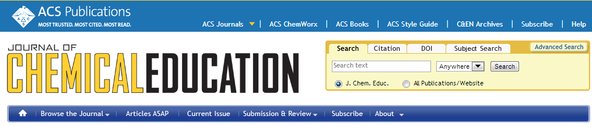
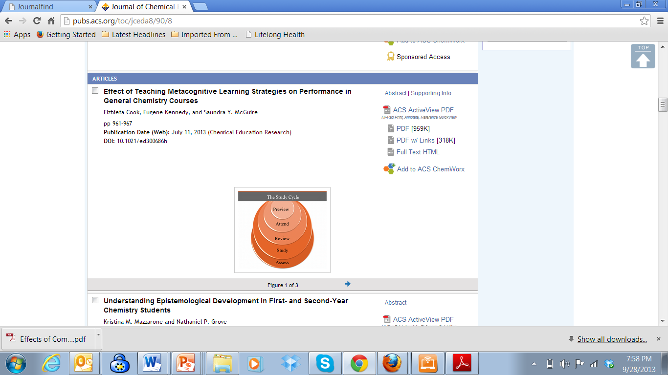
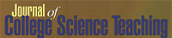
Metacognition: An Effective Tool to Promote Success
in College Science Learning*
Ningfeng Zhao¹, Jeffrey Wardeska¹, Saundra McGuire², Elzbieta Cook²
¹Department of Chemistry, East Tennessee State University
²Department of Chemistry, Louisiana State University
*March/April 2014 issue of JCST, Vol. 43, No. 4, pages 48-54

Slide 50
LSU Analytical Chemistry Graduate Student’s Cumulative Exam Record
2004 – 2005
9/04 Failed
10/04 Failed
11/04 Failed
12/04 Failed
1/05 Passed
2/05 Failed
3/05 Failed
4/05 Failed
2005 – 2006
10/05 Passed
11/05 Failed
12/05 Passed best in group
1/06 Passed
2/06 Passed
3/06 Failed
4/06 Passed last one!
5/06 N/A
Began work with CAS and the Writing Center in October 2005

Slide 51
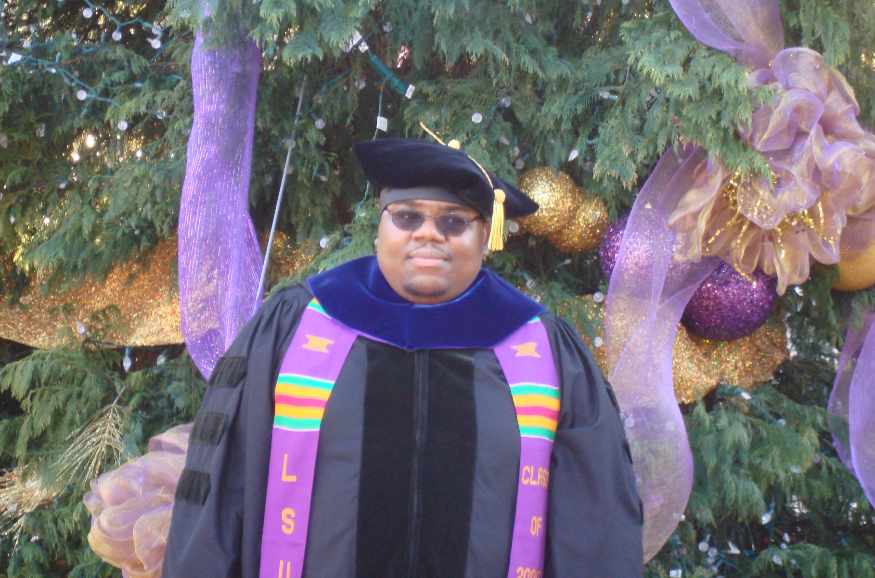
Dr. Algernon Kelley, December 2009

Slide 52
From a Xavier University student to Dr. Kelley in Fall 2011
Oct. 17, 2011
Hello Dr. Kelley. … I am struggling at Xavier and I REALLY want to succeed, but everything I've tried seems to end with a "decent" grade. I’m not the type of person that settles for decent. What you preached during the time you were in Dr. Privett's class last week is still ringing in my head. I really want to know how you were able to do really well even despite your circumstances growing up. I was hoping you could mentor me and guide me down the path that will help me realize my true potential while here at Xavier. Honestly I want to do what you did, but I seriously can't find a way how to. Can I please set up a meeting with you as soon as you’re available so I can learn how to get a handle grades and classes?
Oct. 24, 2011
Hey Dr. Kelley, I made an 84 on my chemistry exam (compared to the 56 on my first one) using your method for 2 days (without prior intense studying). Thanks for pointing me in the right direction. I’ll come by your office Friday and talk to you about the test.
Nov 3, 2011
Hey Dr. Kelley! I have increased my Bio exam grade from a 76% to a 91.5% using your system. Ever since I started your study cycle program, my grades have significantly improved. I have honestly gained a sense of hope and confidence here at Xavier. My family and I are really grateful that you have taken time to get me back on track.

Slide 53
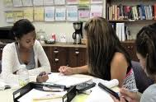
Conclusion
We can significantly increase learning by…
teaching students how to learn
making learning visible
not judging student potential on initial performance
encouraging students to persist in the face of initial failure
encouraging the use of metacognitive tools for deep and integrative learning

Slide 54

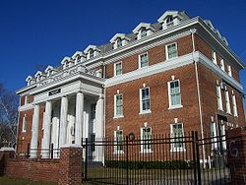
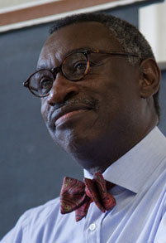
Final Reflection Questions
Who is primarily responsible
for student learning?
a) the student
b) the instructor
c) the institution

Slide 55
Who do you think students say is primarily responsible for student learning?
a) the student
b) the instructor
c) the institution

Slide 56

The reality is that…
when all three of these entities take full responsibility for student learning,
we will experience an increase in learning, retention, and graduation rates!

Slide 57
Useful Websites
www.lsu.edu/students/cas/
www.howtostudy.org
www.vark-learn.com
www.drearlbloch.com

Slide 58
References
Bruer, John T. , 2000. Schools For Thought: A Science of Learning in the Classroom. MIT Press.
Bransford, J.D., Brown, A.L., Cocking, R.R. (Eds.), 2000. How people learn: Brain, Mind, Experience, and School. Washington, DC: National Academy Press.
Christ, F. L., 1997. Seven Steps to Better Management of Your Study Time. Clearwater, FL: H & H Publishing
Cromley, Jennifer, 2000. Learning to Think, Learning to Learn: What the Science of Thinking and Learning Has to Offer Adult Education. Washington, DC: National Institute for Literacy.
Ellis, David, 2014. Becoming a Master Student*. Boston: Cengage Learning.
Hoffman, Roald and Saundra Y. McGuire. (2010). Learning and Teaching Strategies. American Scientist , vol. 98, pp. 378-382.
McGuire, S.Y. (2015). Teach Students How to Learn: Strategies You Can Incorporate into Any Course to Improve Student Metacognition, Study Skills, and Motivation. Sterling, VA: Stylus
Nilson, Linda, 2004. Teaching at Its Best: A Research-Based Resource for College Instructors. Bolton, MA: Anker Publishing Company.
Pierce, William, 2004. Metacognition: Study Strategies, Monitoring, and Motivation.
http://academic.pg.cc.md.us/~wpeirce/MCCCTR/metacognition.htm
*Excellent student reference

Slide 59
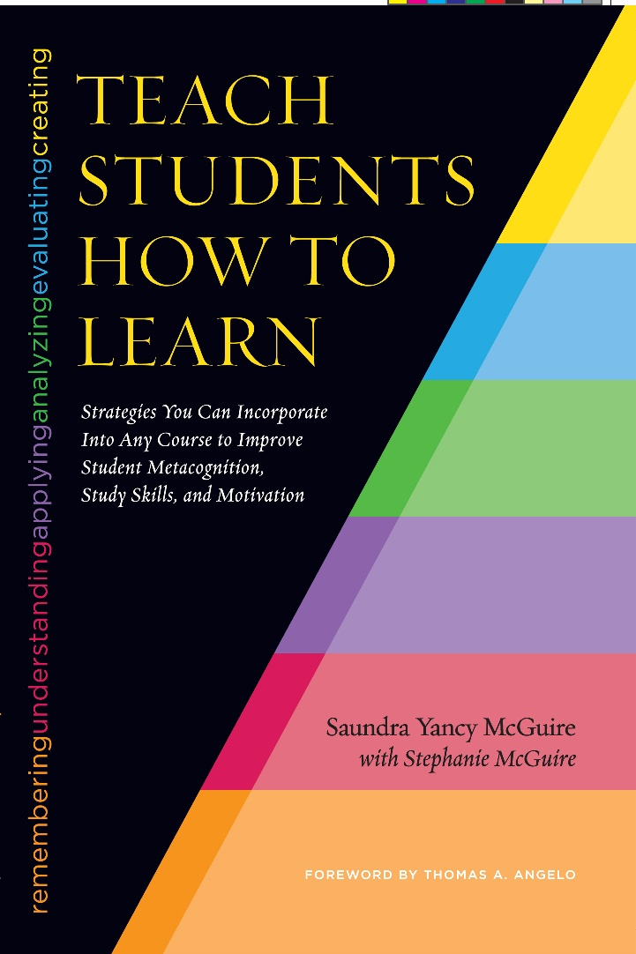
A Recent Reference
McGuire, S.Y. (2015). Teach Students How to Learn: Strategies You Can Incorporate into Any Course to Improve Student Metacognition, Study Skills, and Motivation. Sterling, VA: Stylus

Slide 60
Just out in January…
A Book for Students
McGuire, S.Y. (2018). Teach Yourself How to Learn: Strategies You Can Use to Ace Any Course at Any Level. Sterling, VA: Stylus

