Slide 1
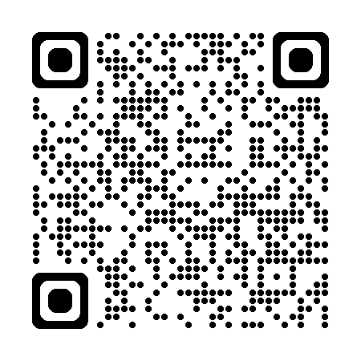
SEEQs
End-of- semester Feedback
Please take the first 10 minutes of class to complete the SEEQs for this course.
SEEQs are available for 3 weeks before final exams begin. They start on a Monday and end on the Sunday before finals.
Notes:
Wait outside the classroom because students will feel pressure if you are in the room.
“Your feedback is important because it helps me understand experience of the course and make changes to improve it for future students.”
“I want to hear from you whether your feedback is positive, neutral, or negative.”
“Your responses help me understand how feel about your engagement with the material, other students, and me.”
“In the past, I’ve made changes to (provide examples to students) based on student feedback.”

Slide 2
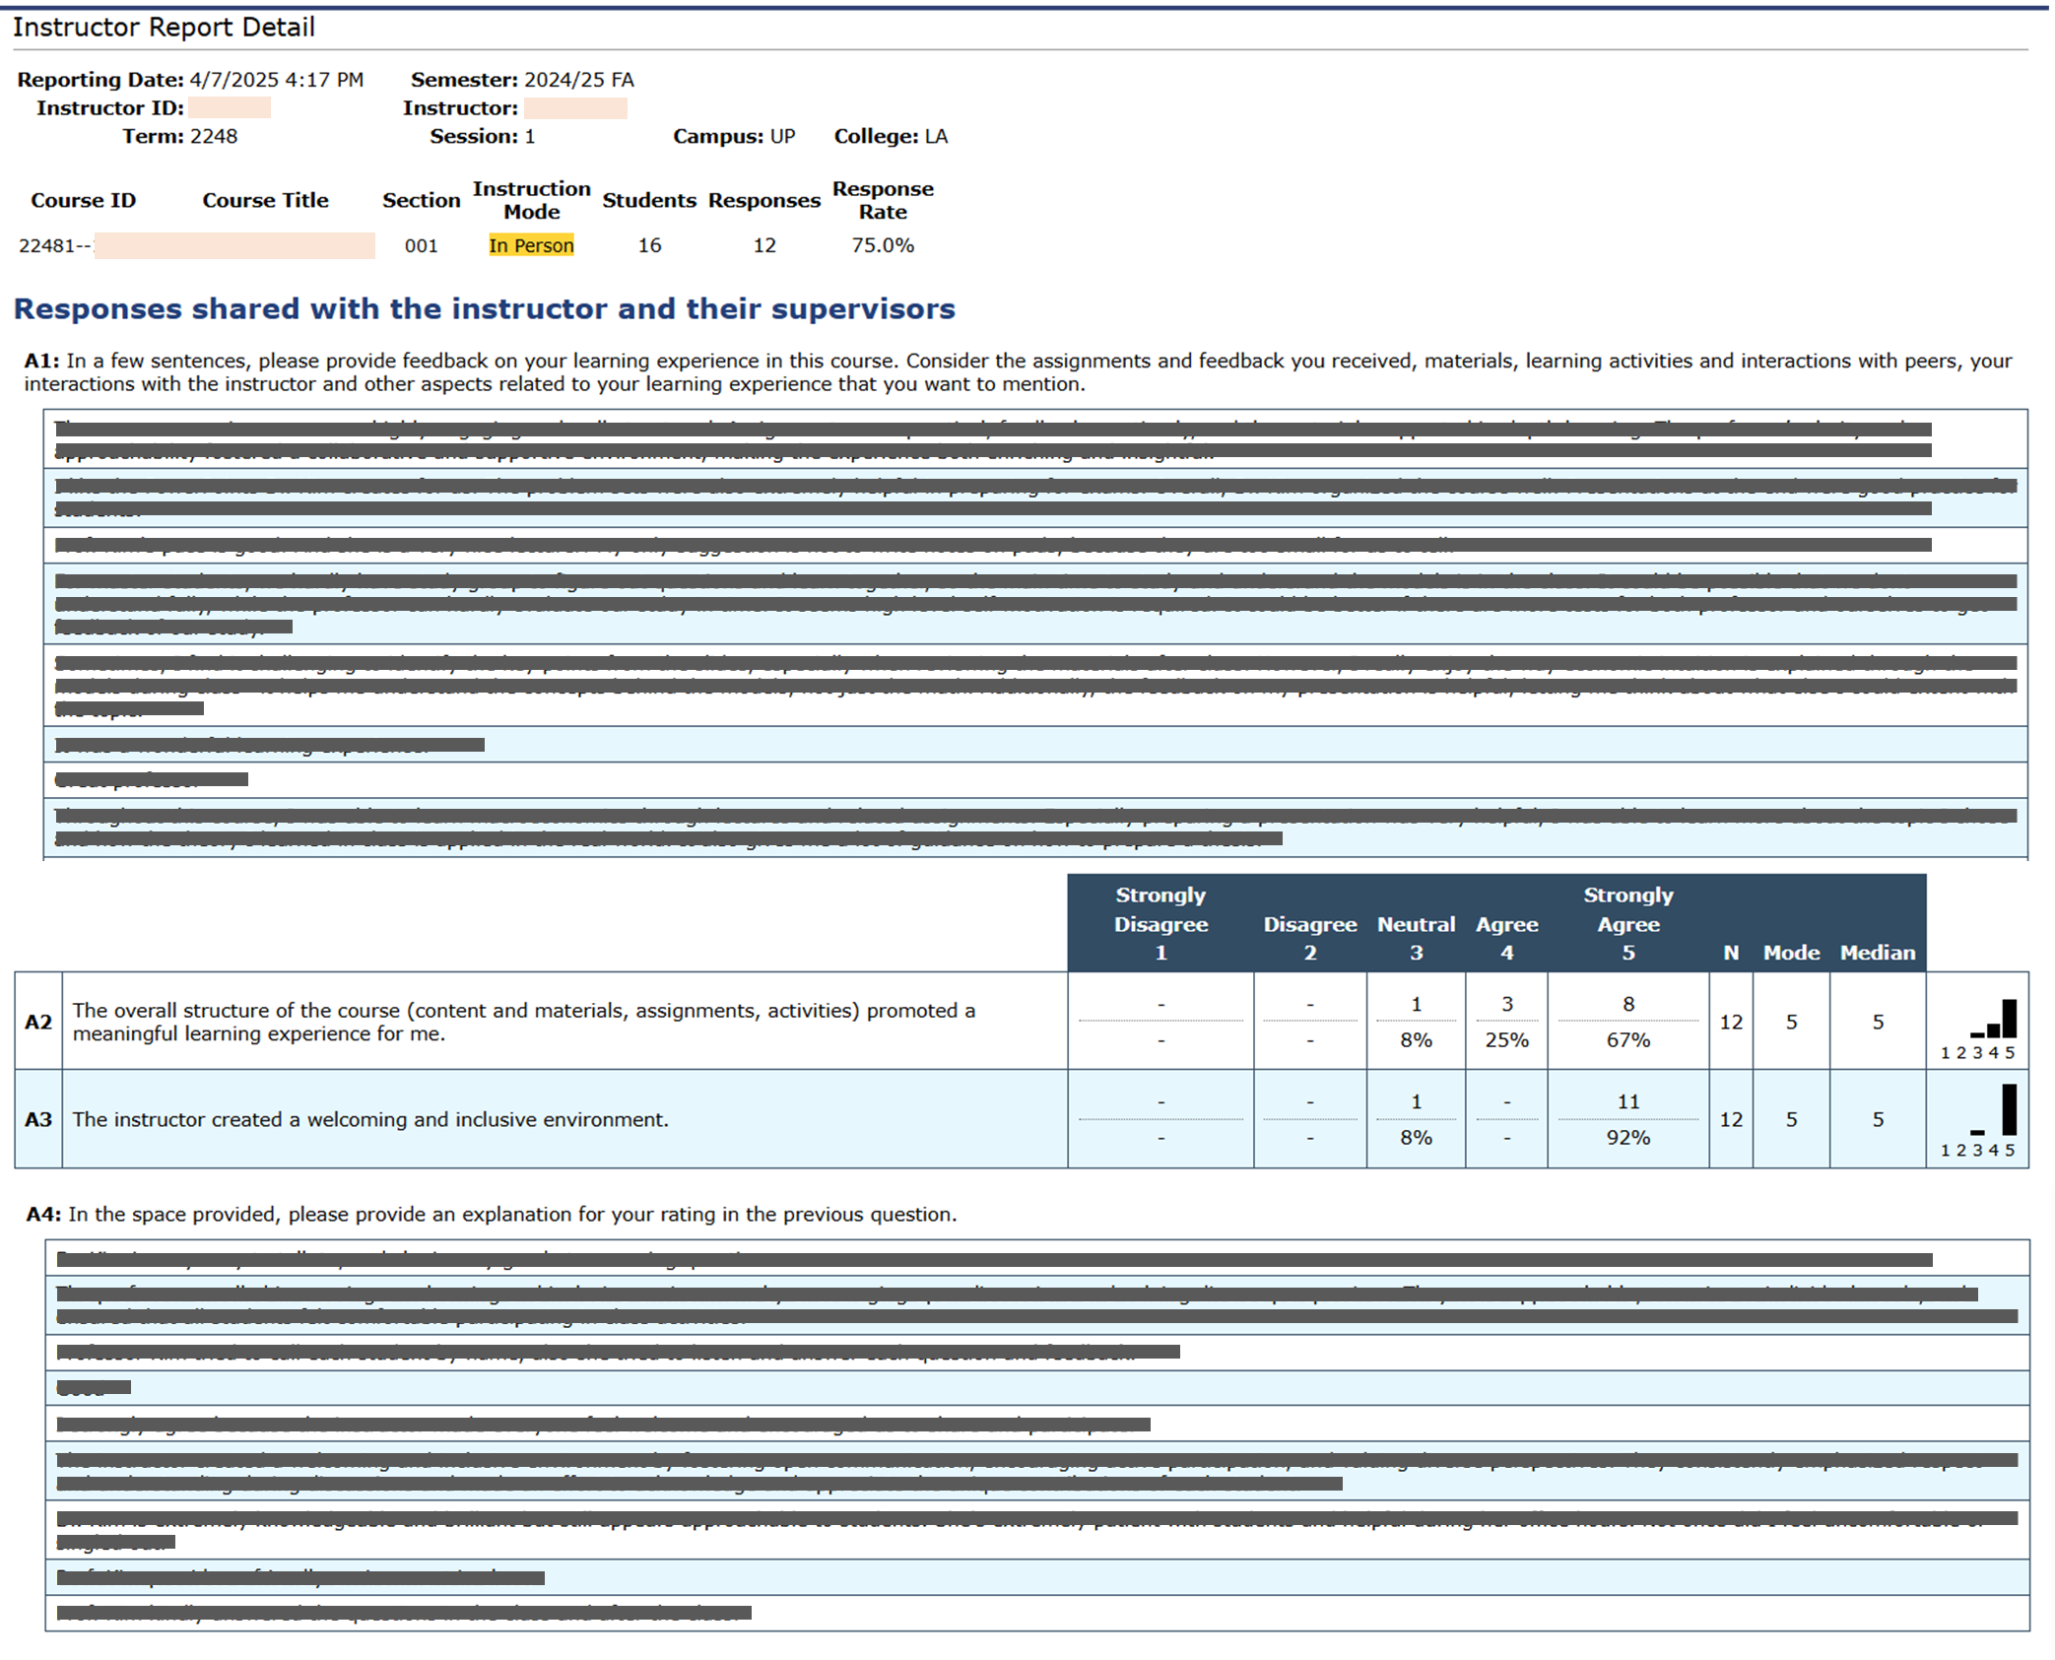
This is a screenshot of the report seen by the Instructor.
Anonymous student responses for each question are grouped together.
Some students skip a question. So the 2nd responses in A1 & A4 might be from different students.
Notes:
Above is a screenshot of a real SEEQ Report, with the student feedback blocked out. Students may be relieved to see a report because it shows that their responses are aggregated and thus anonymous. Each row in the written feedback table represents a different student. Students do not necessarily respond to all questions. As a result, for example, the 3rd response in the open text questions are not necessarily from the same student.

