Slide 1
Managing the Senate Recertification Process
Maggie Slattery, Assistant Dean for General Education
Suzanna Linn, Vice-Chair, Senate Committee on Curricular Affairs (SCCA)
Suzanne Weinstein, Assistant Director of Learning Outcomes Assessment
October 25, 2017
Slides were provided by Michele Duffey, Chair, SCCA

Slide 2
Managing the Proposal Process
Course Recertification
Curricular Review & Approval Process
Curricular Proposal Preparation
Preparing to respond to General Education Prompts

Slide 3
Curricular Review & Approval Process
Senate Approval
New Course/ Change to an Existing Course

Slide 4
Senate Committee on Curricular Affairs (SCCA)
What happens in SCCA?
Review ALL (adds, drops, changes, recertifications) undergraduate course and program proposals
  Subcommittees oversee approvals for General Education, Integrative Studies, Bachelor of Arts, United States and International Cultures, Writing, and Retention and Transfer.
Develop criteria for evaluating proposals
Study courses/ curricular offerings to recommend changes as appropriate to meet the needs of students

Slide 5
Your SCCA Representative
Your SCCA Representative is a Resource
SCCA has a representative for each College at University Park, the University College, and each of the stand-alone campuses. The SCCA representative:
  Thoroughly reviews proposals during the signatory process.
  Serves as a liaison between the College and the SCCA.
  Assists in resolutions of issues when they arise.
SCCA Membership can be found on the Senate website: http://senate.psu.edu/senators/standing-committees/curricular-affairs/members/

Slide 6
SCCA Review of Course Proposals
The Senate Office Receives the Proposal
Recertification courses will be sent to the appropriate subcommittee(s) for review to review the special designation(s).
  IF the special designation is approved, the course is placed directly on the next available Senate Curriculum Report to be reviewed by the entire SCCA membership.
  IF the special designation is rejected or questioned, the course is returned to the proposer(s) for resubmission or clarification. After concerns are addressed, the proposal is returned to the subcommittee.

Slide 7
Curricular Deadlines for 2017-2018
CURRICULUM PROPOSALS DUE | CURRICULUM REPORT PUBLICATION DATE | SCCA COMMITTEE MEETINGS
October 27, 2017 | November 14, 2017 | December 5, 2017
December 15, 2017 | January 9, 2018 | January 23, 2018
February 2, 2018 | February 20, 2018 | March 13, 2018
March 23, 2018 | April 10, 2018 | April 24, 2018
http://senate.psu.edu/senators/important-dates/
Note: A proposal ONLY meets the curricular proposal due date if it is complete and has cleared all relevant subcommittees prior to the due date. In general, a proposal needing subcommittee review should be received by Senate at least 3 weeks prior to the curricular proposal due date.

Slide 8
Curricular Proposal Preparation
Proposal Submission (curriculum.psu.edu)
Consultation

Slide 9
All Curriculum is Faculty-Driven
Faculty Develop Curriculum
All curriculum starts with the faculty.
For curriculum to change or be developed, faculty must initiate the process.
Recertification needs to be collaborative among disciplinary communities

Slide 10
Course Review & Consultation System
(curriculum.psu.edu)
The Curriculum System
Course proposals are created and vetted through the Course Review and Consultation System (CRCS) (www.curriculum.psu.edu)
CRCS will take you through the steps in entering a proposal and will provide all required fields (which will differ based on GenEd domain selection/ if Integrative Studies is chosen).

Slide 11
A Complete Course Proposal
A Complete Course Proposal Has:
Been submitted via www.curriculum.psu.edu
A clear description of the course content
An outline of course topics including time allotment
Evidence of adequate and complete consultation
Been well justified
Adequately completed all required proposal fields, addressing all components/questions
An uploaded sample syllabus (if Gen Ed or Writing)

Slide 12
The Sample Syllabus
Components of the Sample Syllabus
A sample syllabus must be uploaded at the time of course submission for any Gen Ed course and includes:
  Course abbreviation, course number, credit value
  Prerequisites/ Co-requisites/ Concurrent Requirements/ Recommended Prep
  Course Attributes/Designations (i.e. GA, Inter-domain, etc.)
  General Education Learning Objectives
  Course Description (and other critical content)
  Course Learning Objectives
The current sample syllabus template can be found on the Office for General Education website: https://gened.psu.edu/sites/default/files/docs/Syllabus%20Information.pdf

Slide 13
Entering a Proposal for Gen Ed
Tips for Success in Gen Ed Recertification by Navigation Section
Course Designation: be sure to click “Gened Recert” if existing course
Note Course Offering History: lists campuses where the course has been offered over the past 4 years; should help proposer develop at least a portion of a consultation list
Course Information: must indicate “General Education” under “Learning Attributes”
GenEd Requirements: select 2-4 GenEd Learning Objectives
Knowledge Domain Criteria: select 3-5; address questions (for each domain); address integrative studies questions if applicable
Consultation: enter consultants and “submit request for Consultation”

Slide 14
Gen Ed Learning Objectives
(all Gen Ed courses)
Addressing Gen Ed Learning Objectives
Select 2-4 GenEd Learning Objectives (GELOs)
For each GELO:
  explain which aspects of the course fulfills the learning objective; need to demonstrate that students have adequate opportunity to achieve the stated GELO
  Provide examples how students could be assessed to determine achievement of the GELOs
  Not just the assessment (an exam, essay etc), but how that assessment relates to the GELO
  The assessments are examples because they could vary by instructor, course size, delivery mechanism (online, hybrid etc)

Slide 15
Gen Ed
Domain-Specific Criteria
(all Gen Ed courses)
Addressing Gen Ed Domain-Specific Learning Criteria
Select the appropriate course listing (single-domain, inter-domain, linked, or foundation)
  The appropriate prompts will be presented (i.e. single-domain GA will present the GA criteria, GQ foundation will present the GQ criteria)
Select at least 3 of the 5 criteria for each domain selected
Describe the components of the course that aid in fulfilling the domain-specific learning criteria selected
If inter-domain or linked is selected, additional integrative studies prompts will appear

Slide 16
General Tips for Integrative Studies Courses
(only Linked or Inter-domain courses)
Inter-Domain
Need to justify the presence of content appropriate for a 50/50 split of 2 domains
Consultation needed with appropriate faculty in both domain disciplines
Course reviewed in GenEd and Integrative Studies Subcommittees. *Can extend time to approval.
Use the suffix of “N” at time of proposal submission to easily identify an inter-domain course.
There cannot be a proposal for N and non-N version of a course (and still meet both the 50/50 and 80/20 standards).
Linked
Need to submit EACH course to approve the single domain on a course
  Proposals would also include the linkage between the two courses
Consultation needed for each course in domain discipline and consultation to support the linkage(s)
Courses each reviewed in GenEd and Integrative Studies Subcommittees. *Can extend time to approval.
Use the suffix of “Z” to easily identify a linked course (NEW); can propose a non-Z version for flexibility in offering (change)

Slide 17
Inter-domain Course Prompts
Inter-domain Courses
Every proposal is different in content, structure, and vision. Prompts will require:
  Explanations of how students will address/integrate material and details of the concepts/ topics addressed by each domain; descriptions of translating information to practice
  Explanations of how students will integrate material by detailing the concepts/ topics addressed by each domain
  Evidence of widespread consultation and substantial consultation with faculty with expertise in the knowledge domain, discipline, and cross-listed discipline (if applicable); explanation of unit(s) and College(s) support for the course is necessary
  Details of knowledge base, skills, and/or abilities and qualifications of an instructor are necessary (avoid naming individual(s)) for durability; may include notations of communication among affected units and collaborations with campuses likely to offer the course.
  Discussing HOW assessment method(s) show application of integrative thinking (i.e. portions of a final project that require “x”)

Slide 18
Linked Course Prompts
Linked Courses
Every proposal is different in content, structure, and vision. Prompts will require:
Explanations of how students will address/integrate material and details of the concepts/ topics addressed by each domain; descriptions of translating information to practice
Highlighting specific purposeful linkages that can be drawn between material in both courses that provide opportunities for students to experience and practice integrative thinking across knowledge domains
  Evidence of widespread consultation and substantial consultation with faculty with expertise in the knowledge domain(s) and discipline(s); explanation of unit(s) and College(s) support for the course is necessary
  Details of knowledge base, skills, and/or abilities and qualifications of an instructor are necessary (avoid naming individual(s)) for durability; may include notations of communication strategies among affected units and collaborations with the other instructor and campus personnel likely to offer the course and support the linkage.
  Discussing HOW assessment method(s) show application of integrative thinking (i.e. portions of a final project that require “x”)

Slide 19
Consultation
(all courses)
Consultation is Required for All Courses
The purpose of consultation is to ensure all units affected by an addition to or proposed change in curriculum have the opportunity to voice concerns and/or suggest improvements.
Consult with:
  all campuses where course has been taught in the last 4-5 years
  all campuses departments/programs delivering similar content
  all departments/programs/campuses affected by a change (i.e. content, a prereq, a program requiring that course)
  disciplinary communities who may share content (i.e. sustainability affects many) or may have duplication
  librarians (resources)

Slide 20
Who is doing what
Associate Deans have a list of GenEd courses by college/unit that originated the course.
OGE and LOA are encouraging disciplinary communities to coordinate
Participate in consultation and proposal preparation when requested.

Slide 21
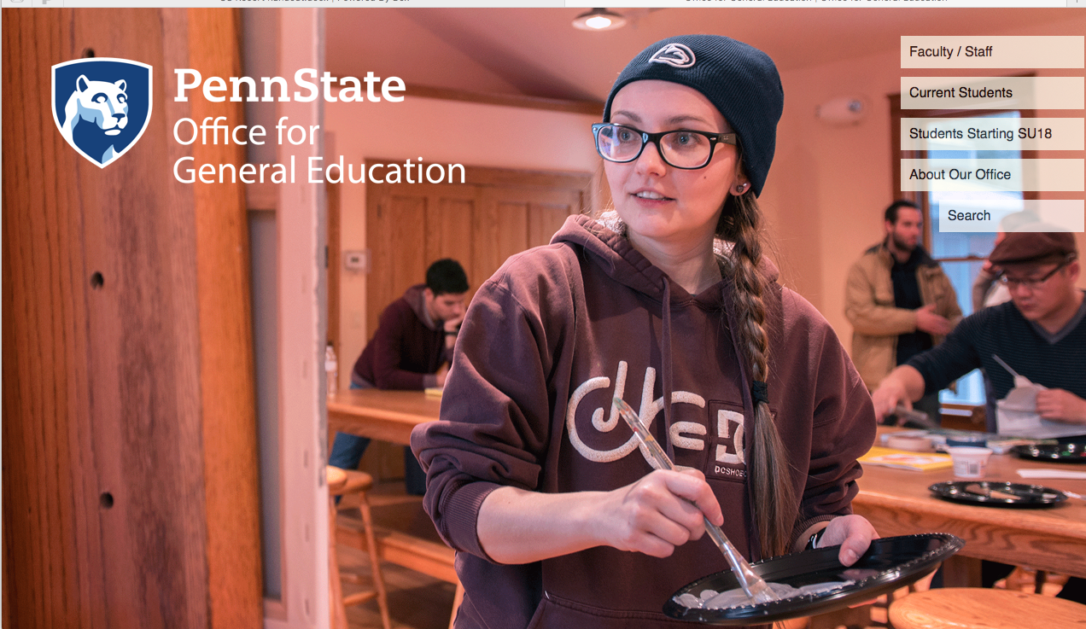
Resources
Job Aid – Word Doc
Sample proposal
Sample Syllabus
Integrative Studies SCCA process webinar

Slide 22
Curricular Work Flow
From Faculty Development to Senate Approval

Slide 23
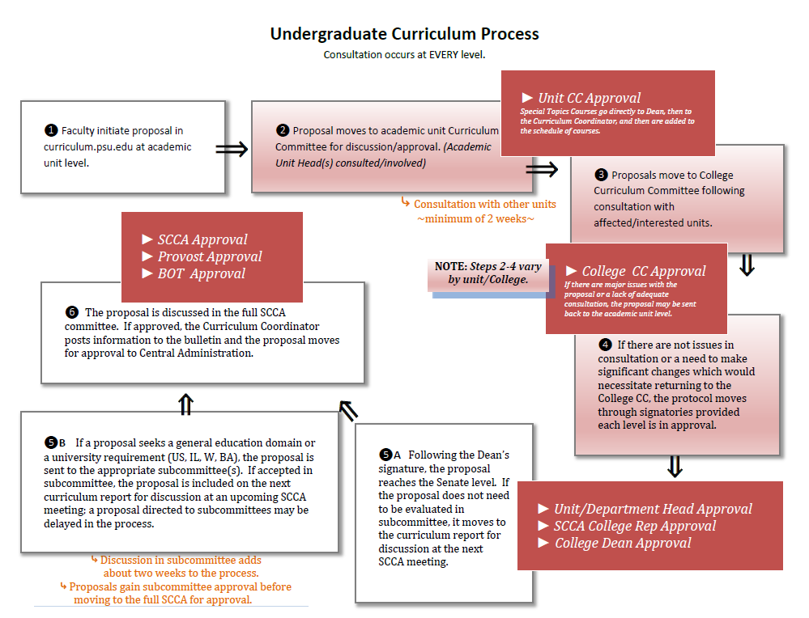

Slide 24
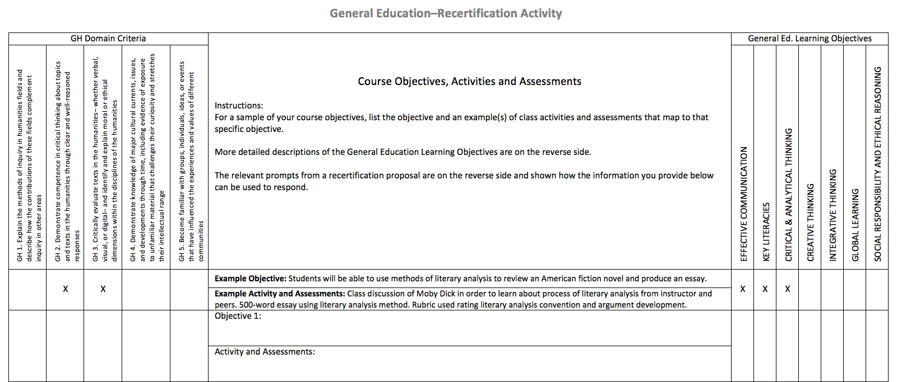

Slide 25
